Slide 1
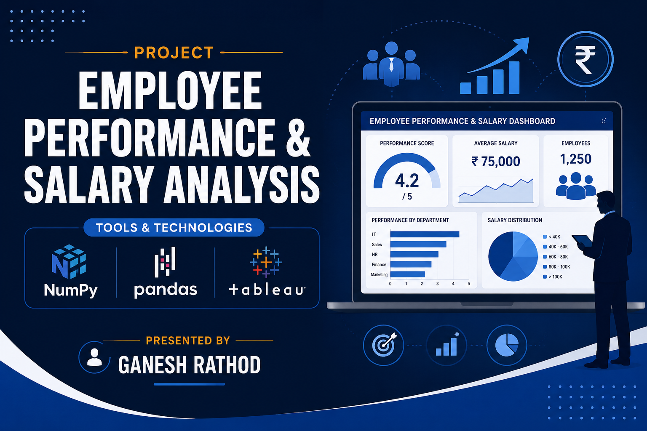

Slide 2

Introduction
2
The Employee Performance and Salary Analysis project focuses on analyzing employee-related data to understand the relationship between employee performance, salary, experience, workload, and other important factors. The project uses employee information such as department, experience, monthly salary, performance score, projects completed, working hours, leaves taken, and customer satisfaction.

Slide 3
Project Objectives
3
To analyze employee performance.
To analyze salary distribution among employees.
To study the relationship between experience and salary.
To compare employee performance across departments.
To analyze projects completed and working hours.
To study customer satisfaction.
To create an interactive Tableau dashboard.

Slide 4
Dataset Description
4
Dataset
The dataset contains employee-related information such as:
Employee ID
Employee Name
Age
Gender
City
Department
Experience Years
Monthly Salary
Performance Score
Projects Completed
Working Hours
Leaves Taken
Customer Satisfaction
New Salary
Performance Category
Experience Category
Dataset Size: 30 Records × 13 columns

Slide 5
Technologies Used
5
Technology | Purpose
Jupyter Notebook | Interactive data analysis, coding, visualization, and model testing
Pandas | Data cleaning and manipulation
NumPy | Numerical calculations
Tableau | Data visualization and dashboard creation
CSV | Dataset storage

Slide 6
Data Preprocessing
6
Data Cleaning & Preprocessing
Imported the dataset using Pandas.
Checked the structure and data types.
Checked for missing values.
Checked for duplicate records.
Verified numerical and categorical data.
Organized the data for analysis.
Prepared the cleaned dataset for Tableau visualization.

Slide 7
Tableau Dashboard
7
Department-wise Average Salary
Experience vs Salary
Employee Performance Score
Projects Completed by Department
Working Hours vs Performance
Leaves vs Performance
Customer Satisfaction
Gender-wise Employee Distribution

Slide 8
Future Scope
8
Integrate real-time employee data.
Use Machine Learning for performance prediction.
Predict future salary growth.
Develop employee attrition prediction.
Automate HR reports.
Connect Tableau with live databases.
Build an advanced HR analytics system.

Slide 9
Conclusion
9
The project successfully analyzes employee performance and salary data.
Pandas was used for data cleaning and manipulation.
NumPy was used for numerical analysis.
Python was used for data processing and analysis.
Tableau was used to create interactive visualizations.
The project provides useful insights into employee performance, salary, productivity, and satisfaction.
Data analytics can help organizations make better HR decisions.

Slide 10
Thank You
10

